Slide 1
BRAND PORTAL DASHBOARD
BROWN BAG SESSION

Slide 2
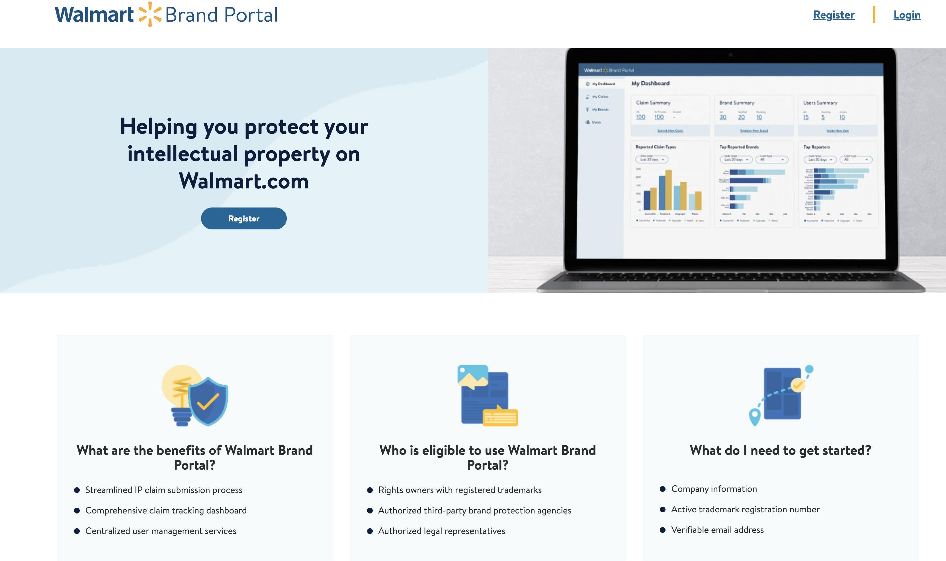
What Is Brand Portal?
Brand Portal, also known as RoPro - Rights Owner Protection Program is the portal that will act as the interface for brands and rights owners. It will allow owners of intellectual property (IP) rights and their authorized representatives to report Walmart.com listings that may infringe on those rights. Rights Owners can register their brands onto the brand portal, update company/brand/trademark information, add/remove reporters and raise and track claims.

Slide 3
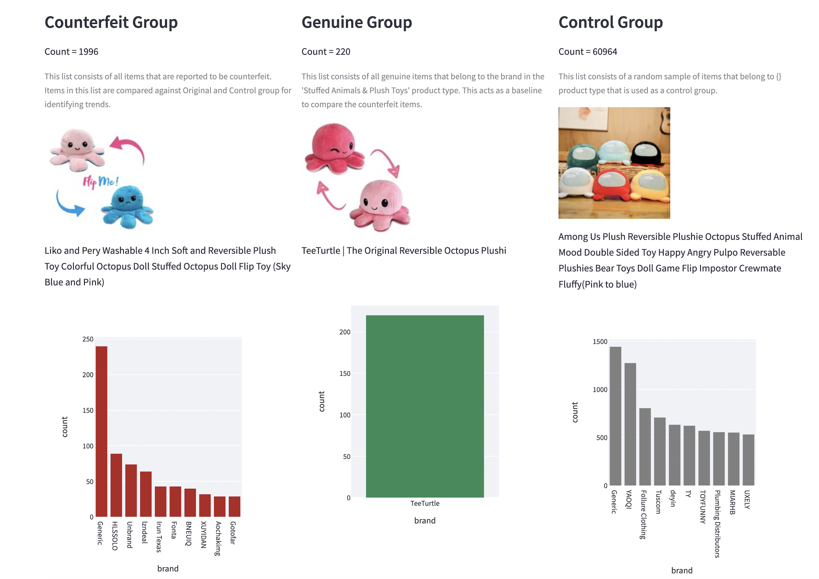
What Are Counterfeit Items? (And why we should care)
Counterfeit goods are intended to appear authentic but are fake.
Walmart would be liable for legal suits by sellers exasperated due to the impact on their business by counterfeit sales
Customers or Sellers can raise a counterfeit claim using the IP Web Form of Brand Portal - Any mention of details supporting why a product may be counterfeit and/or a test purchase placed will warrant a counterfeit investigation.

Slide 4
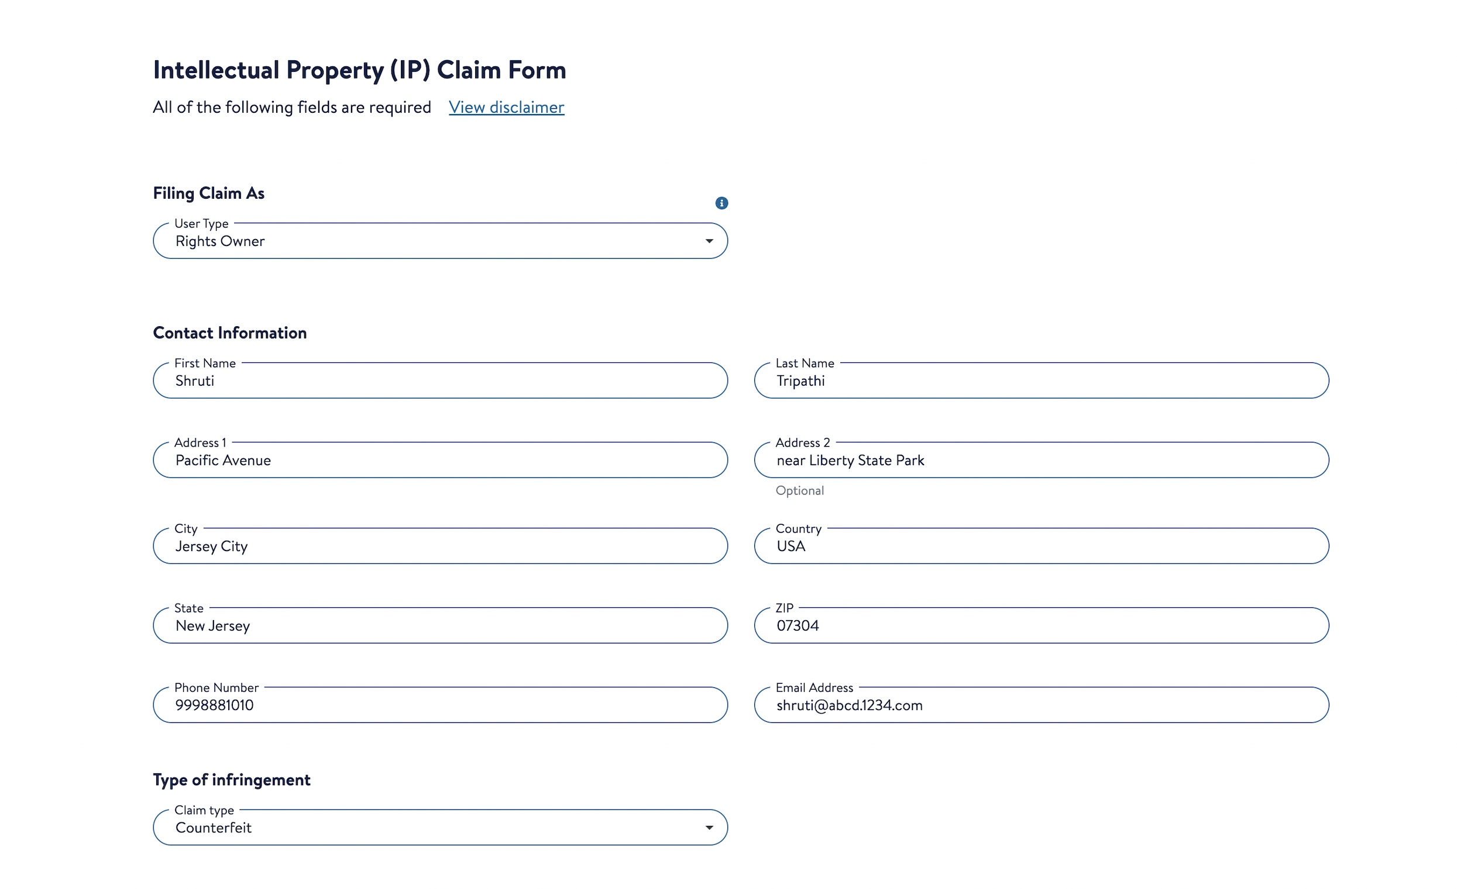
Current Process To Report Claims
The rights owner can report listings by going to https://help.walmart.com/ and clicking on Report Alleged IP Infringement under Other Support. On this page, there is a link at the bottom of the page IP Claim Form. After clicking on this link, rights owners can report for the below IP infringements:
Copyright
Trademark
Patent
Counterfeit
After selecting one of the above options, a web form needs to be filled out. Once the web form is submitted, a case is created which gets investigated by the manual reviewers. Based on the infringement, below are some of the immediate actions:
Item page is brought down
Seller is removed from the item page
Seller is asked for more information and is given two weeks to respond
Seller is asked to contact the rights owner and settle the dispute

Slide 5
Challenges With The Current Process
To report an infringement, the above webform mentioned needed to be filled out and submitted. Our current challenges:
Login is not required for filling the form
We don't know whether the user raising the infringement claim is authorized to do that
This exposes a vulnerability which can be exploited by fraudsters. Fraudsters can start reporting the items of other sellers. Even without knowing the authenticity of the claim, we start taking actions on the items and the sellers.
We don't check the devices the claim requests are coming from
There is a high chance of sellers using this to sabotage their competition
Communication to sellers and BD is currently done manually
There is no way to track whether the seller has responded back to a query on an IP claim
Currently brands/rights owners:
Can't search/find all of their listings in one place
Can't report infringements in bulk
Can't track the progress of their infringement claim
Can't upload their trademarks and patent information, which can be used to actively find infringement cases
Can't nominate and authorize agencies to take actions on their behalf
Can't do reverse image and content check to detect suspected listings with counterfeit/IP abuse
Can't remove the items and listings on their own

Slide 6
What Will Brand Portal Do About This?
RoPro embodies our commitment to provide a safe place for merchants on Walmart.com to report their claims.
Counterfeit goods and other intellectual-property-infringing listings will continue to be posted to Walmart’s e-commerce platforms, despite Walmart’s best efforts to proactively mitigate abuse. (We do have a high righ detection model in production now to pro-actively identify CF items and take them down, yay!!)
Brand holders need an efficient and easy way to report these abuses to Walmart Trust and Safety, which in turn needs an efficient way to process these complaints. Brand Portal helps provide a safe and reliable channel to raise and track these claims.
It also helps create a strong brand-holder authentication process- to prevent abuse of the intellectual property complaint process by counterfeiters, fraudsters, and sellers and identify invalid claims.

Slide 7
Brand Portal Dashboard Useful Links:
https://confluence.walmart.com/pages/viewpage.action?spaceKey=CDF&title=RoPro%3A+Rights+Owner+Protection+Program
https://confluence.walmart.com/pages/viewpage.action?spaceKey=CDF&title=Information+Architecture+-+Brand+Portal
https://confluence.walmart.com/display/CDF/Brand+Portal+Roadmap

Slide 8
Thankyou!!

